Slide 1
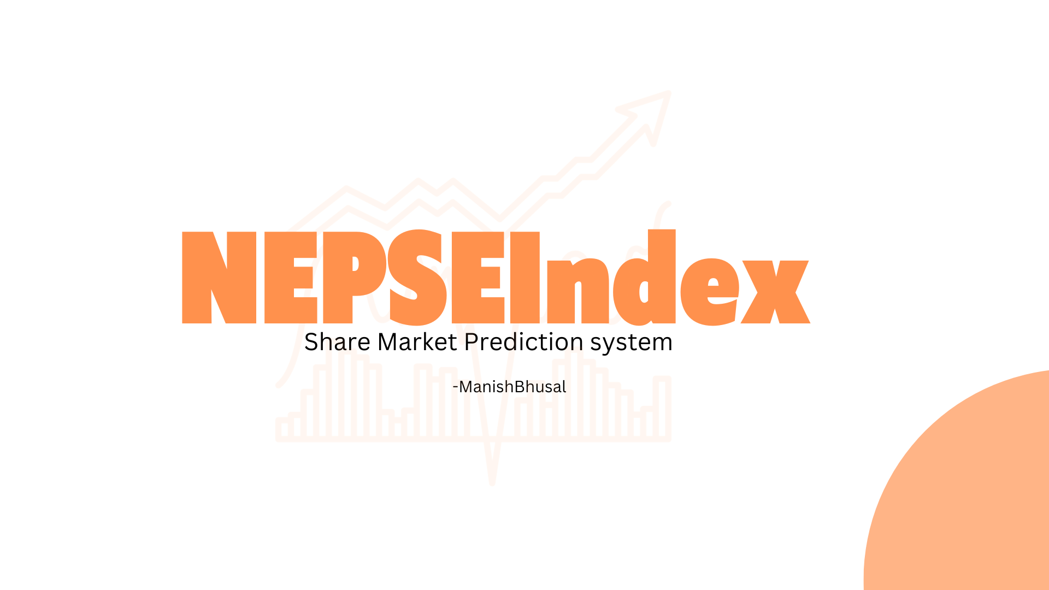

Slide 2

Problem Of Statement
Market volatility
Lack of diversification
Emotions and biases
Lack of information

Slide 3
Objective
to providing investment advice, a stock buy, hold, and sell site may also offer educational resources to help investors better understand the stock market and make more informed decisions.

Slide 4
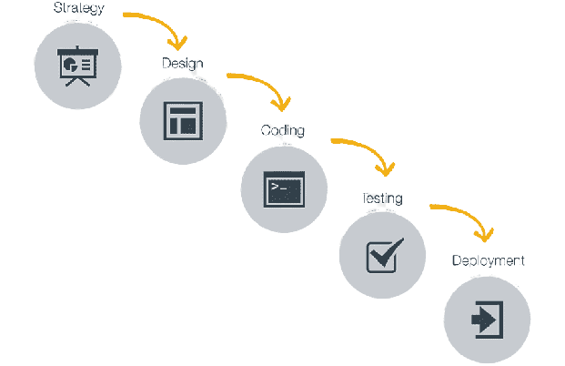
Water Fall Model
Methodology

Slide 5
Algorithm: LSTM
Long Short-Term Memory (LSTM) is a type of recurrent neural network (RNN) architecture designed to capture long-term dependencies in data. Unlike traditional feedforward neural networks, LSTM networks have feedback connections. It can process not only single data points but also entire sequences of data, making them well-suited for tasks involving sequences and time series prediction. Here are the key components of an LSTM network:

Slide 6
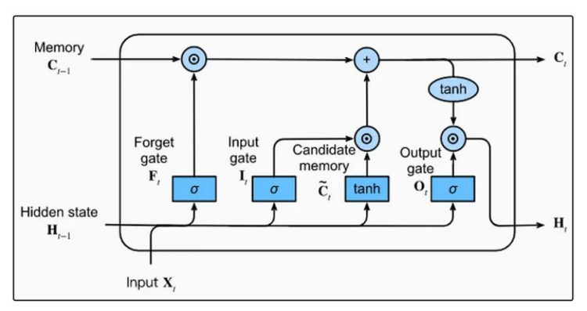
Algorithm: LSTM
Figure 3.3: LSTM Algorithm of NEPSEInsider

Slide 7
Requiremnt Analysis
Admin:
Admin can sign up for the account.
Admin will manage NEPSE API.
Admin will manage user data.
user :
User can login and signup to the system.
Only valid user is permitted to access the system.
User can search required Stock.
User gets stock Prediction.

Slide 8
Requiremnt Analysis
Admin:
Admin can sign up for the account.
Admin will manage NEPSE API.
Admin will manage user data.
user :
User can login and signup to the system.
Only valid user is permitted to access the system.
User can search required Stock.
User gets stock Prediction.

Slide 9
Data Modeling
NEPSE Data
CSV

Slide 10
Process Modeling
NEPSE Data
CSV

Slide 11
Implement Tools
Frontend Tools
HTML
CSS
JS
Backend Tools
Python
Flask

Slide 12
Conclusion:
NepseInsider has been designed to address the challenges faced by beginner investors in the complex world of stock prediction. Traditionally, novice investors had to rely on multiple Nepse sites and online news sources for stock information, leading to time-consuming and often inaccurate self-analysis. This process not only consumed valuable time but also resulted in doubts and uncertainties about their predictions, increasing the risk of financial loss. To tackle these issues, NepseInsider was developed using the structured waterfall model. The development process began with thorough analysis, followed by meticulous design, development, and rigorous testing before deployment. The goal was to create a user-friendly platform that simplifies the stock prediction process, ensuring accurate results for investors.

